Slide 1
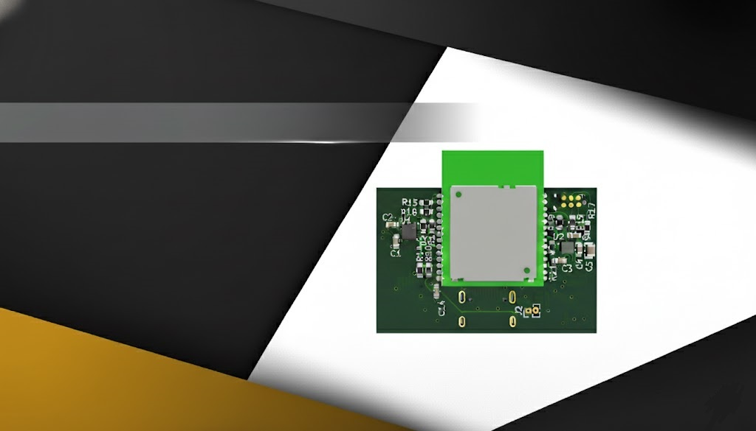


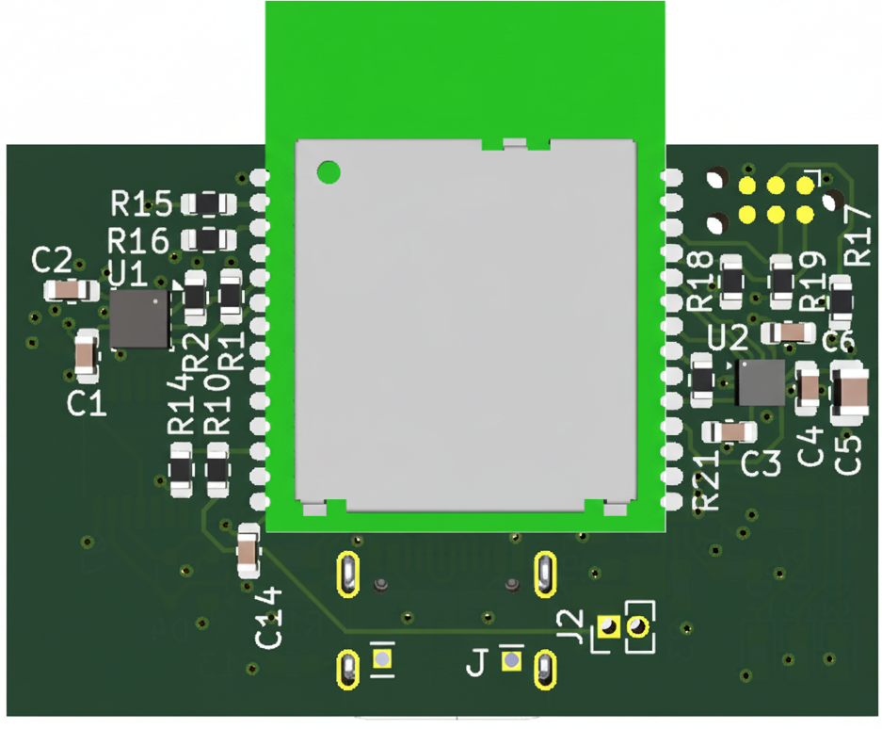
Design of a Wireless Indoor Tracking System for Multi-Sensor Data Acquisition with BLE Channel Sounding
Name: Vasiloglou Athanasios
Advisor: Prof. Evangelos V. Hristoforou, NTUA
Date: 24/10/2025
ECE
NTUA

Slide 2
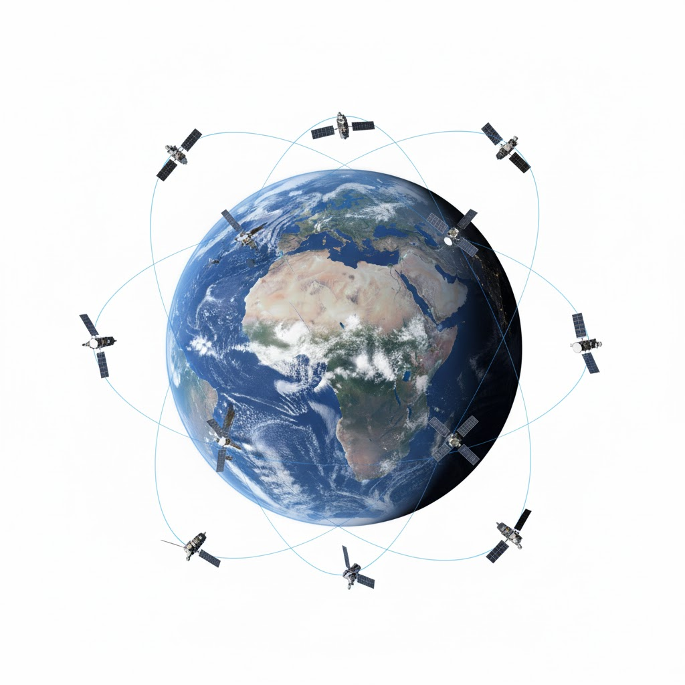

Introduction
2

Slide 3
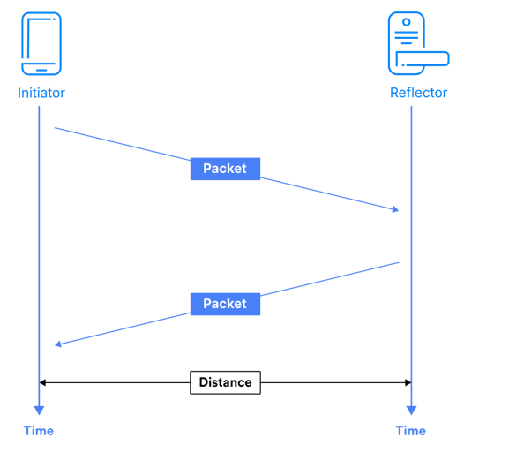
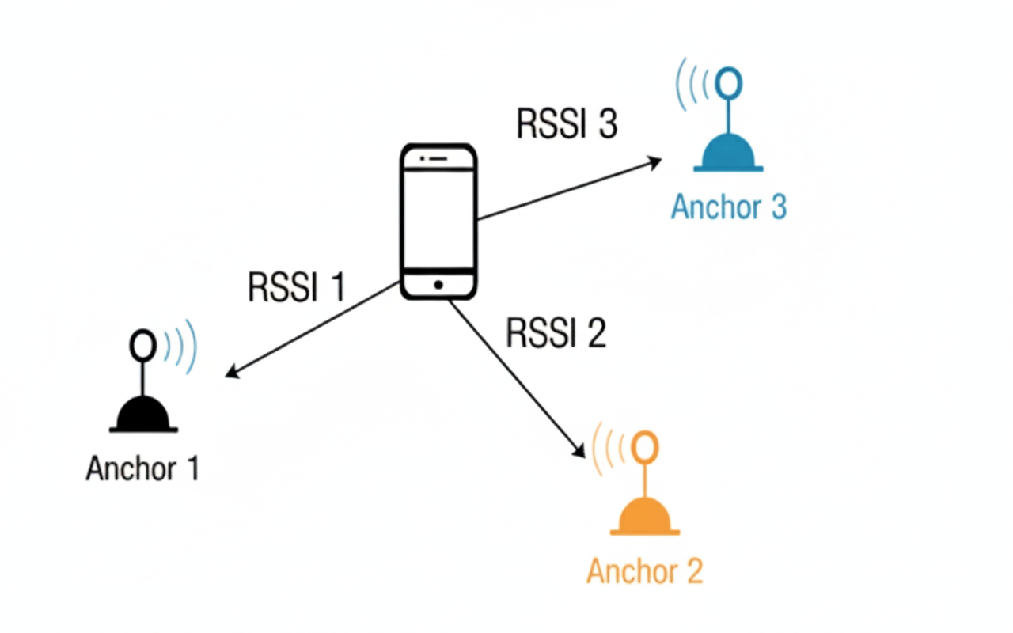
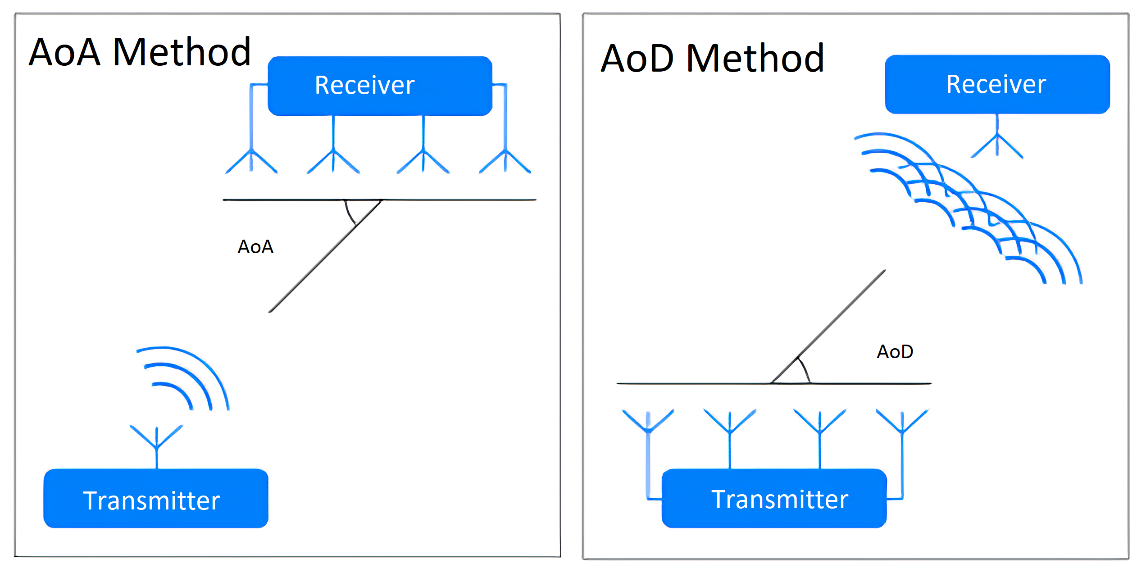
BLE Positioning Approaches
3
RSSI (Received Signal Strength)
AoA / AoD (Direction Finding arrays)
Channel Sounding (BLE 6.0)

Slide 4
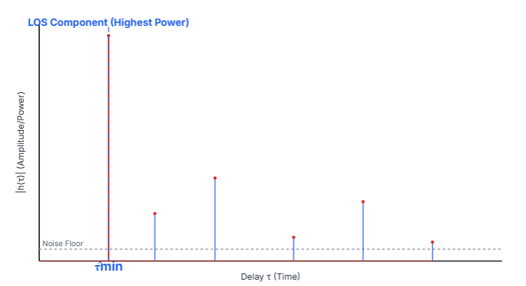
IFFT Based Ranging
4
Inverse Fast Fourier Transform
IFFT Logic
Measure channel transfer H(f) on multiple tones
Apply IFFT → CIR to expose first arrival peak
First detectable path delay → distance = c·τ
Strong in LOS, stable in mild multipath
Q&A

Slide 5
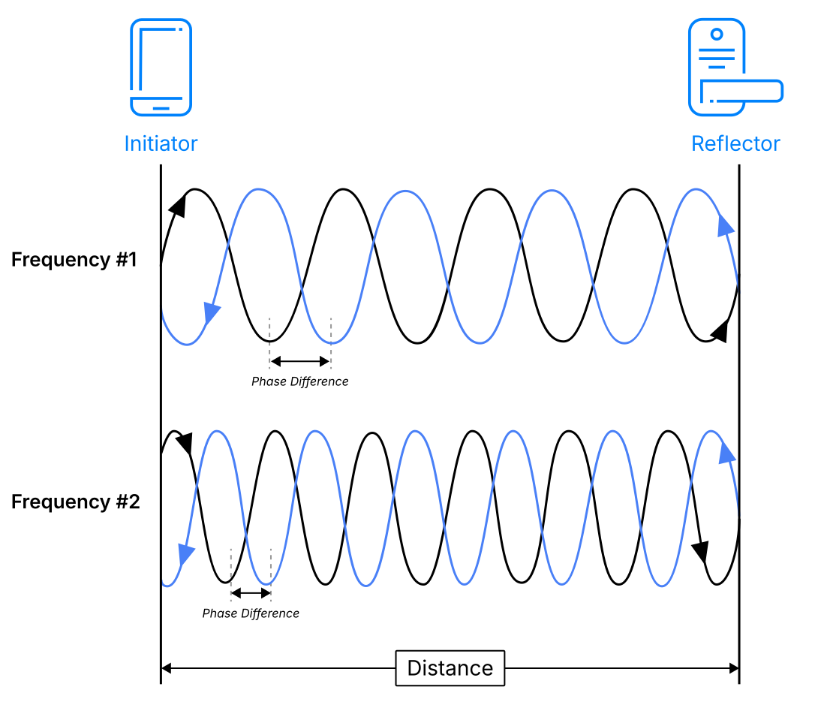
Phase Based Ranging
5
PBR Logic
Phase of tones shifts with distance
Compare across frequencies
Multi-tone fit resolves 2π wrapping
Q&A

Slide 6
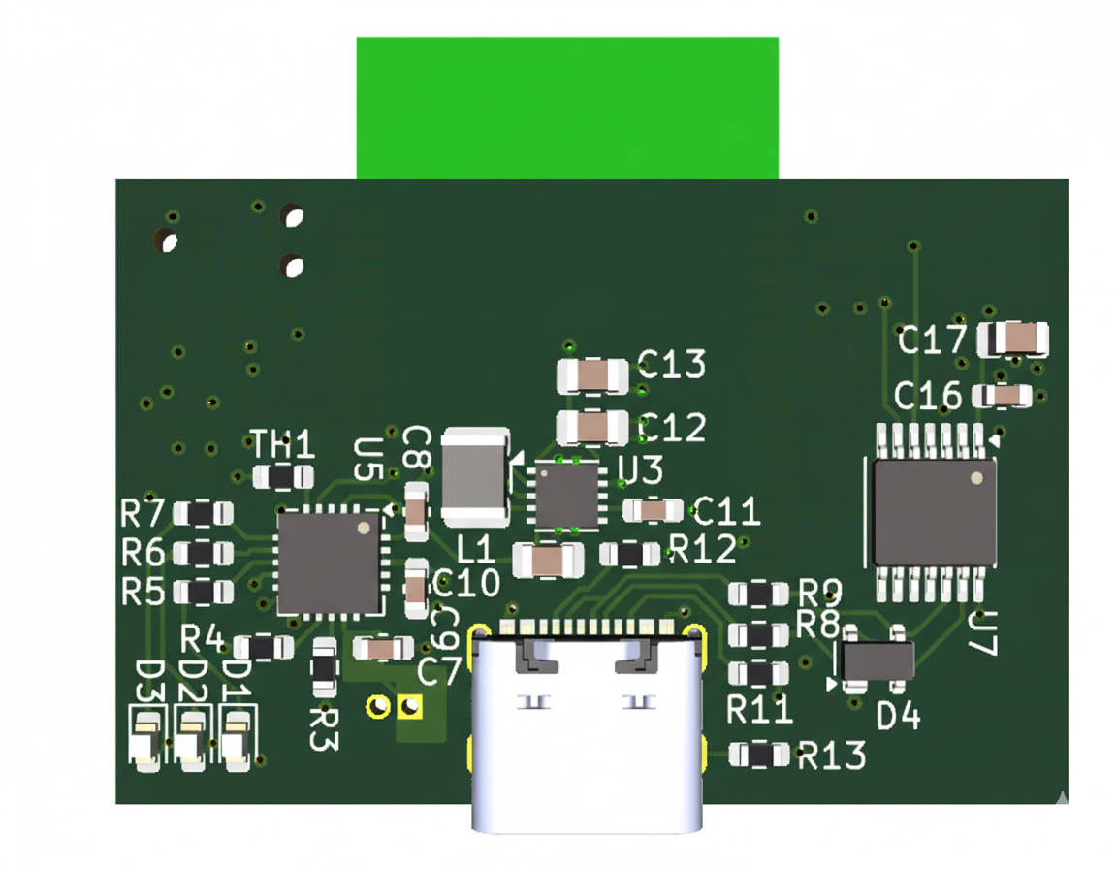
Hardware Design
Q&A

Slide 7
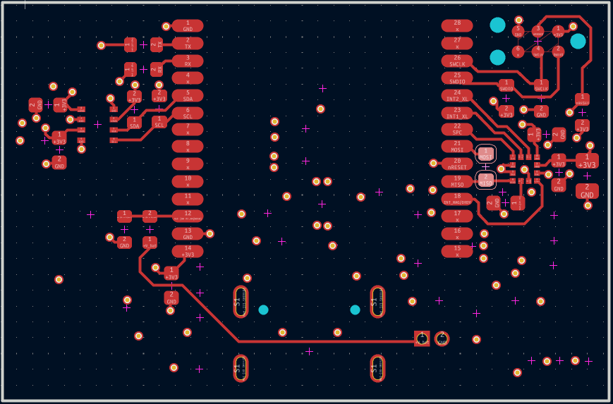
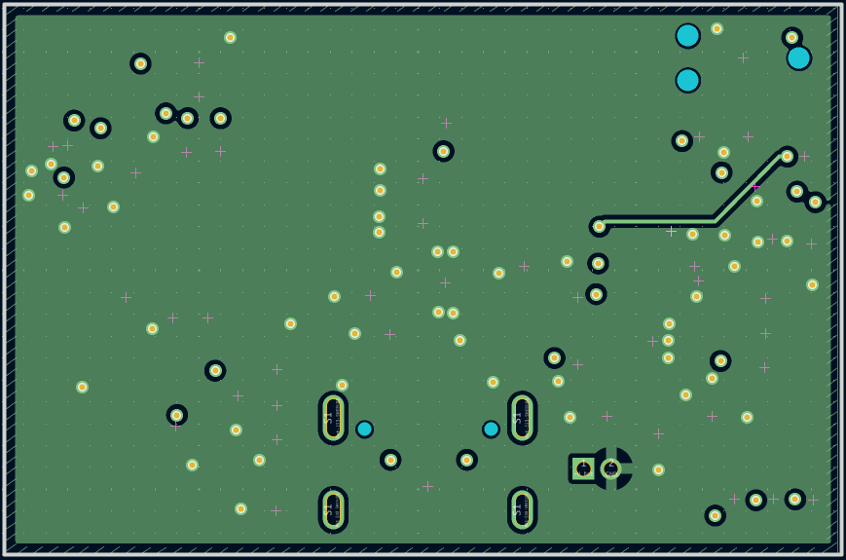
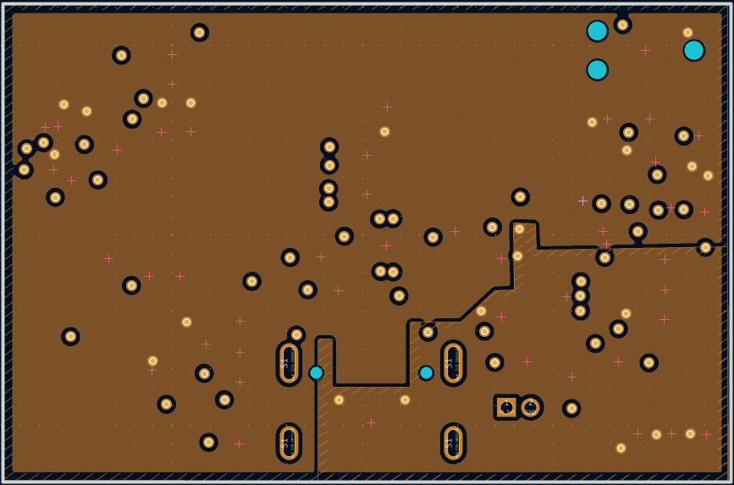
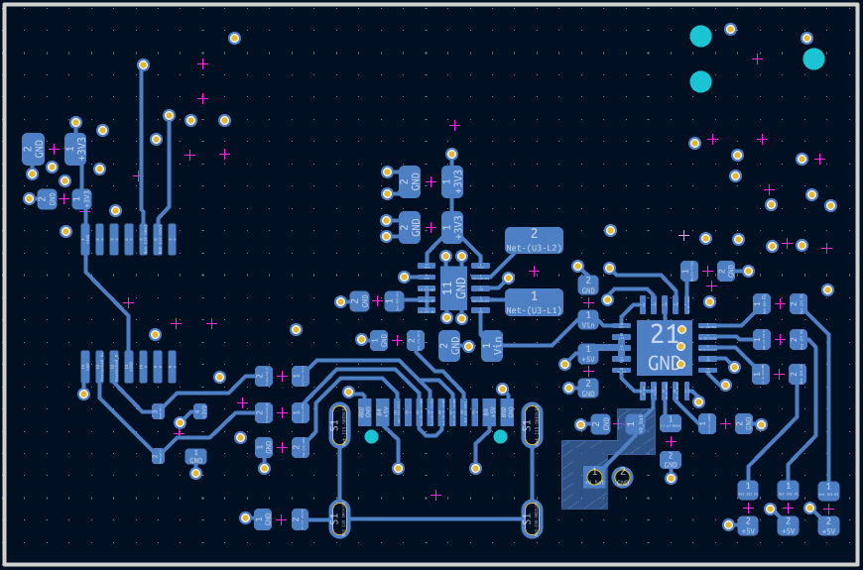
Hardware Design
7
PCB Stack Up
Top layer
Signals
ME54BS01 module
Sensors
First inner layer
Ground
Second inner layer
Power Plane
3V3
5V
Bottom layer
Power Management
USB Differential Pair
Q&A

Slide 8
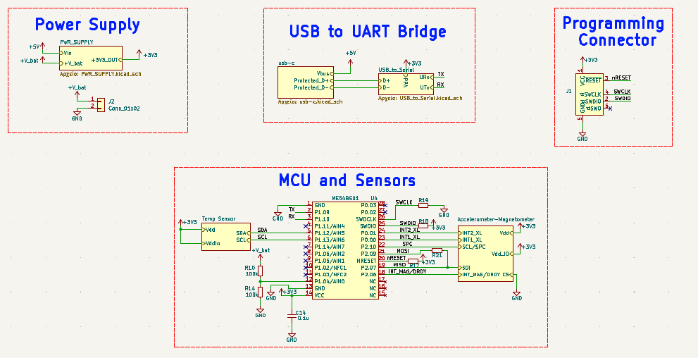
Schematic Diagram
8
Q&A

Slide 9
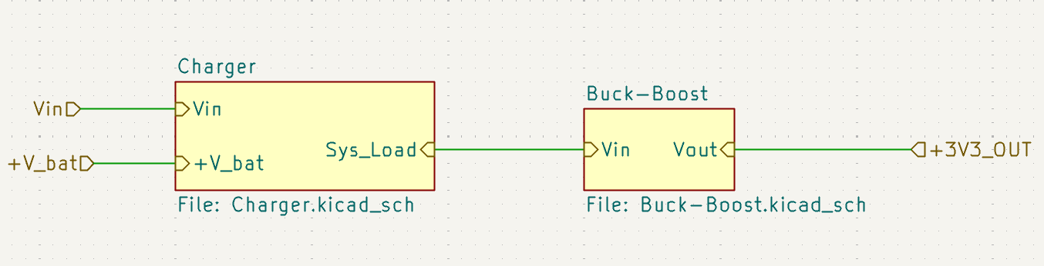
Power Supply
9
Q&A

Slide 10
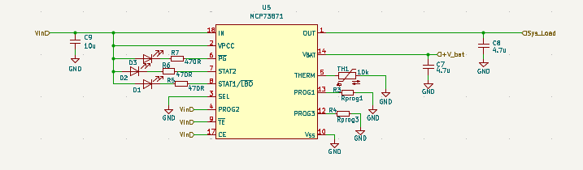
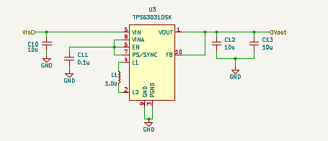
Power Supply
10
Battery Charger
Buck – Boost Converter
Q&A

Slide 11
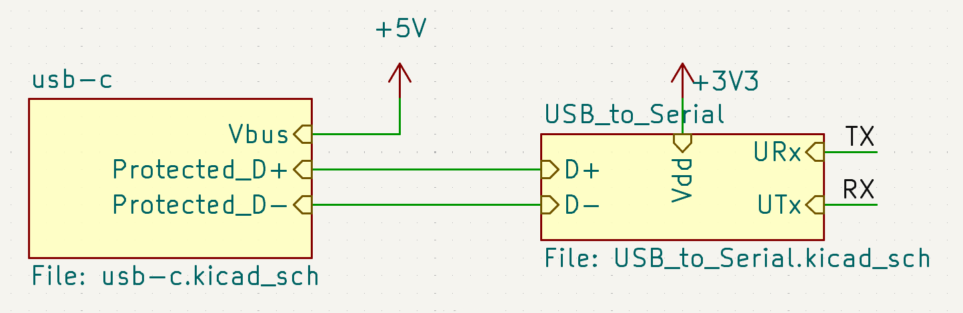
UART – USB Bridge
11
Q&A

Slide 12
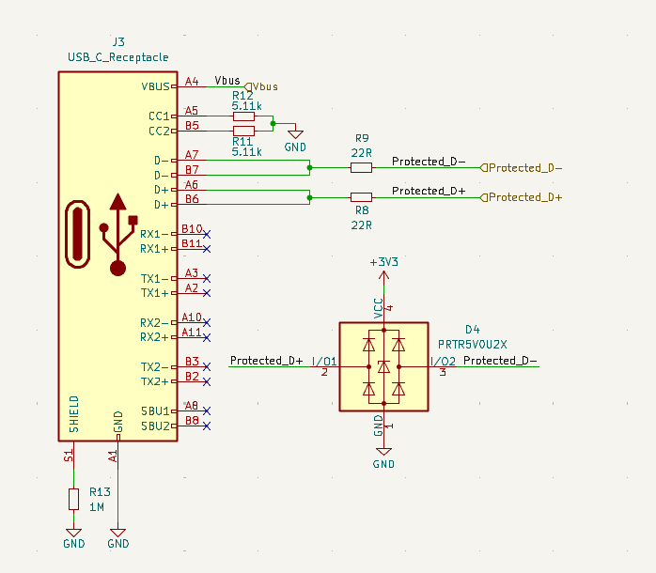
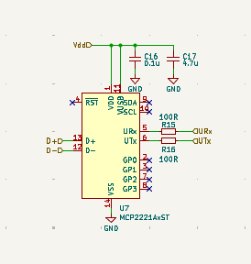
UART – USB Bridge
12
Type – C Connector
UART – USB Bridge
Q&A

Slide 13
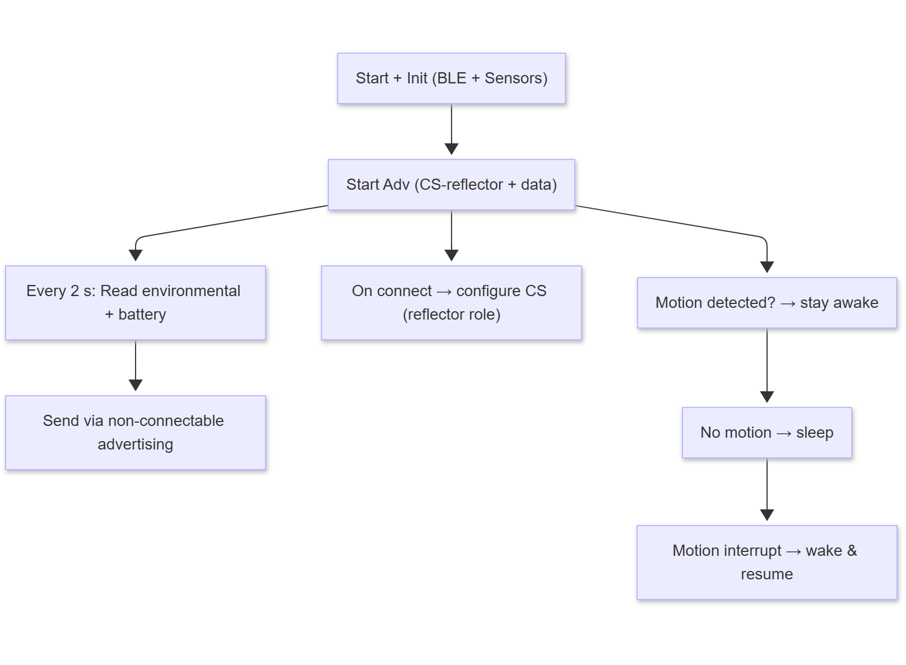
Reflector Firmware
13
Flowchart
Q&A

Slide 14
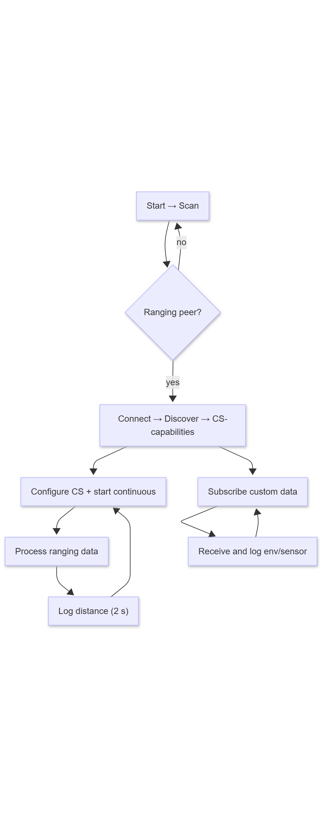
Initiator Firmware
14
Flowchart
Q&A

Slide 15
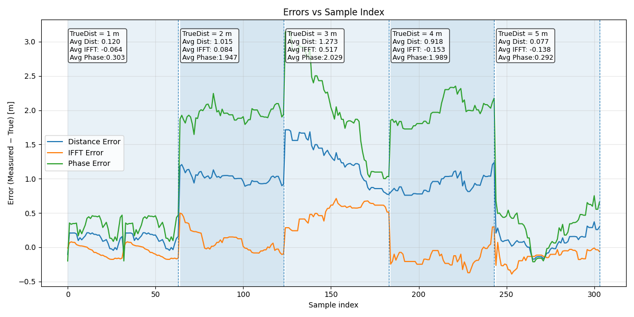
Results
15
First Testing Set up
Average IFFT error : 0.049 m
Average PBR error : 1.312 m
Average Dist error : 0.650 m
Q&A

Slide 16
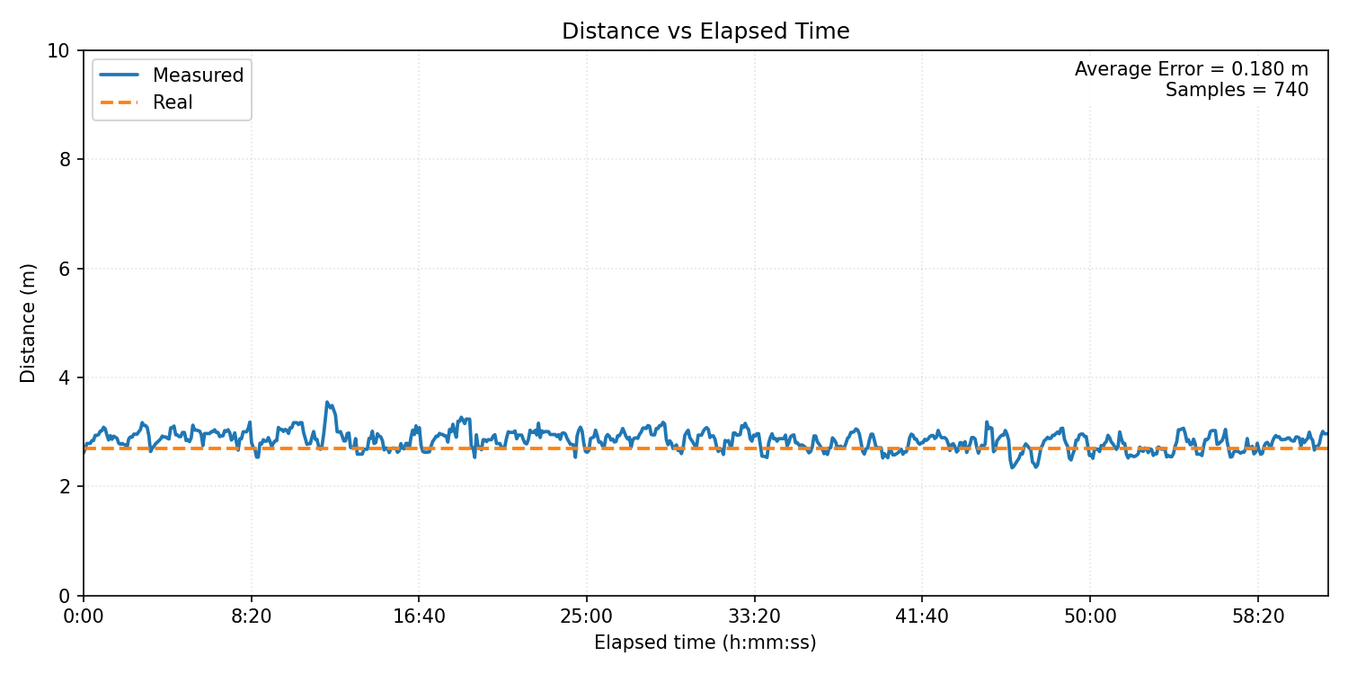
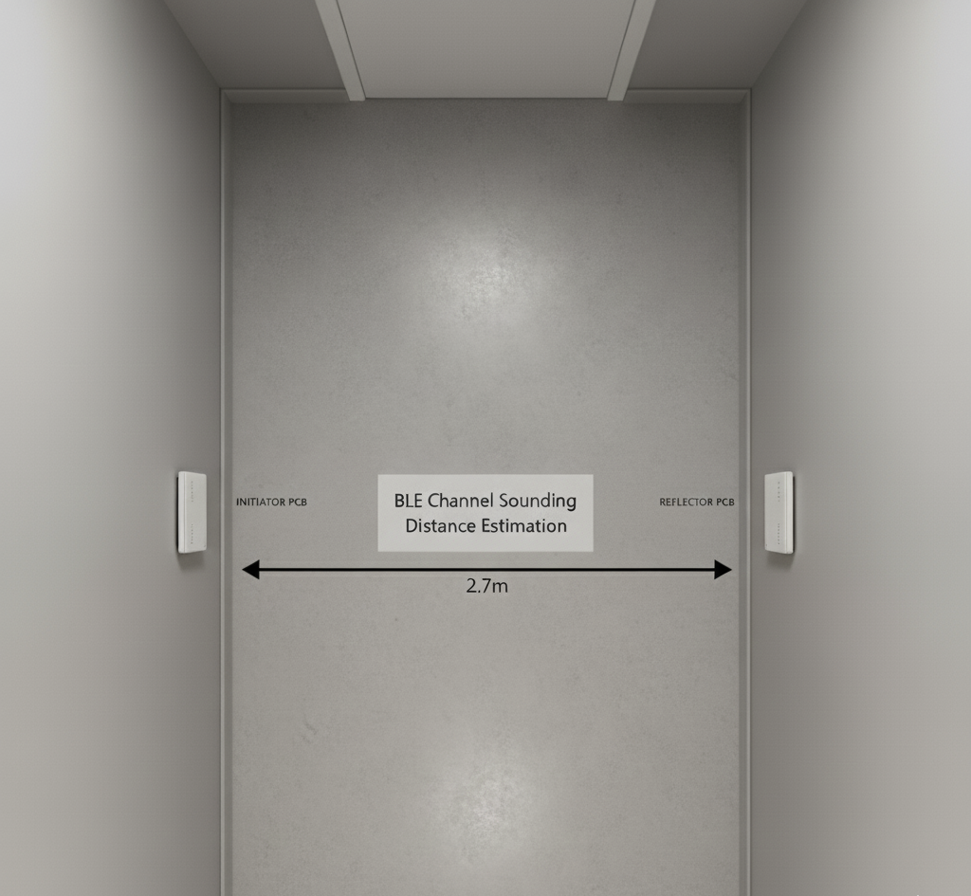
Results
16
Second Testing Set up
Q&A

Slide 17
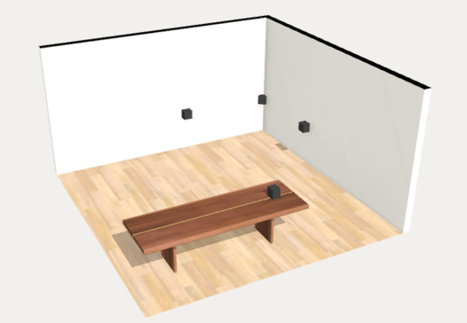
Results
17
Third Testing Set up
Initiator | Distance to Target (m)
Initiator 1 | 4.0
Initiator 2 | 4.5
Initiator 3 | 3.0
Q&A

Slide 18
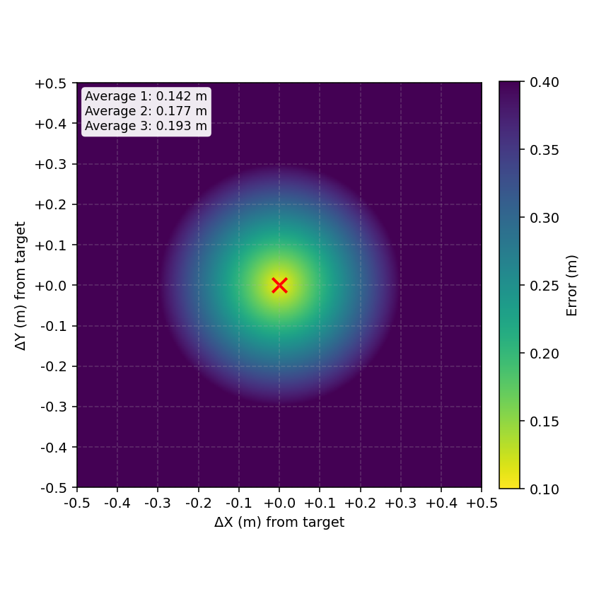
Results
18
Error Heat Map
Initiator | Average error (m)
Initiator 1 | 0.142
Initiator 2 | 0.177
Initiator 3 | 0.193

Slide 19
19
Conclusions and Perspectives
19
Results
Summary
Sub-meter ranging achieved
Modular & scalable Solution
Cost-effective design
Further Work
Complete real-time supervision software
Anchor hardware optimization
Targeted initiator/reflector hardware
More experiments about 3D mapping
Q&A
19

Slide 20

Thanks for your Attention!
20
Q&A
Theory
BLE Position Approaches σελ.3
IFFT Based Ranging σελ.4
Phase Based Ranging σελ.5
Firmware Implementation
Reflector Firmware Flowchart σελ.13
Initiator Firmware Flowchart σελ.14
Results
First Testing Set Up σελ.15
Second Testing Set Up σελ.16
Third Testing Set Up σελ.17
Hardware Implementation
PCB 3D Model σελ.6
PCB Layers σελ.7
PCB Schematic σελ.8
Power Supply Implementation σελ.9
UART - USB Bridge σελ.11
CONCLUSIONS & PERSPECTIVES

